Slide 1
Checking understanding of rounding
Estimation and rounding

Slide 2
how to use Oak lessons

Slide 3
I can round to the nearest 100 or 10 or whole number or to 1 or 2 decimal places.

Slide 4
Rounding means to change a number into another number that is approximately the same value but is easier to work with. E.g. round 561 to the nearest 10 is 560.

Slide 5

Checking understanding of rounding
Rounding to 10, 100 & 1000
Rounding to the nearest whole number
Rounding to one or two decimal places

Slide 6
Rounding to 10, 100 & 1000
Rounding is useful for showing the approximate value of something without being exact.
E.g. The number of people living on a street
The number of pupils at a school
The distance between your home and school
The attendance at a pop concert
The distance between the Earth and the Moon

Slide 7
Rounding to 10, 100 & 1000
Rounded values make them easier to work with.
The number of people living on a street is 72.
Giving this to the nearest ten gives us an idea of the size of the street but doesn’t need to be exact.
When rounding to the nearest ten, firstly we identify the multiples of 10 either side of the number.
2 away from 70
8 away from 80
72
70
80
72 is closer to 70.
Therefore, 72 to the nearest 10 is 70.

Slide 8
Rounding to 10, 100 & 1000
The number of people attending a pop concert is 68 562.
Giving this to the nearest thousand gives us an idea of the size of the concert and doesn’t need to be exact.
When rounding to the nearest thousand firstly we identify the multiples of 1000 either side of the number.
562 away from 68 000
438 away from 69 000
68 562
68 000
69 000
68 562 is closer to 69 000.
Therefore, 68 562 to the nearest 1000 is 69 000.

Slide 9
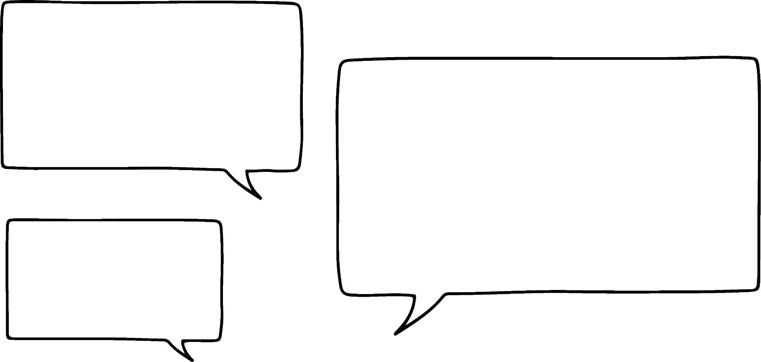
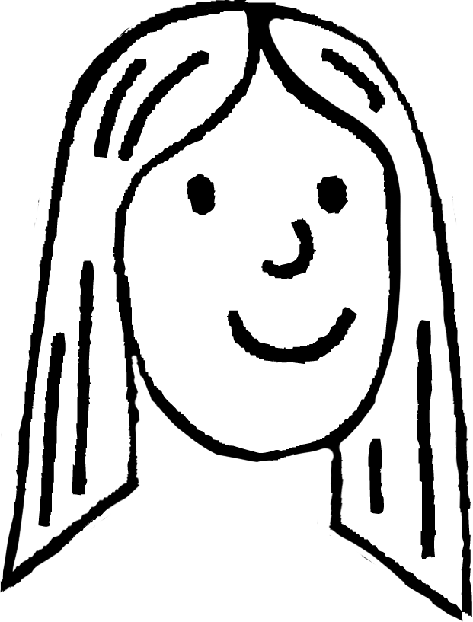
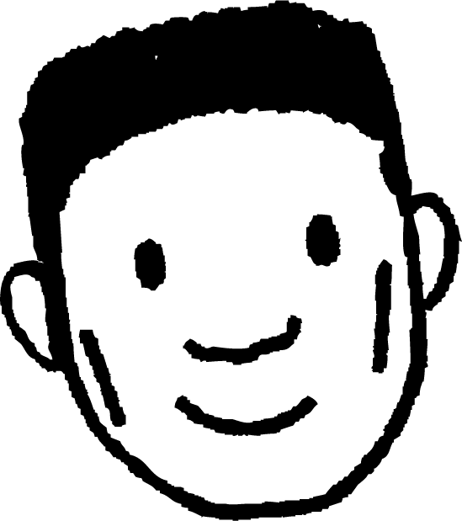
Rounding to 10, 100 & 1000
What is 135 rounded to the nearest 10?
5 away from 130
5 away from 140
135
130
140
When the number is exactly halfway between the 2 multiples we always round up to the larger.
So, 135 is 140 to the nearest 10.
Lucas
Laura

Slide 10
Rounding to 10, 100 & 1000
We can use Laura’s fact to help us round numbers without having to work out the distance from each multiple.
E.g. What is 3587 to the nearest hundred?
Identify the multiples of 100 either side of 3587.
3587
3500
3550
3600
Find the halfway point.
Decide which multiple of 100 your number is closer to.
3587 rounded to the nearest hundred is 3600.

Slide 11

Rounding to 10, 100 & 1000
5672 to the nearest ten is 70.
The digit after the 7 in the tens column is less than 5.
The thousands and hundreds digits have been missed off.

Slide 12
Rounding to 10, 100 & 1000
To show that we have rounded numbers we can use the ‘approximately equal to’ symbol.
For example, if you round 15 865 to the nearest 10 you could write:
15 865 ≈ 15 870
You might see what a number has been rounded to written after the rounded number:
15 865 ≈ 16 000 (to the nearest 1000)

Slide 13
Rounding to 10, 100 & 1000
Find the incorrect statement in each row.
Record the letter. When you have all 7, rearrange them into a word.
Rounded to nearest
10 | 82 ≈ 80 | 65 ≈ 60 | 27 ≈ 30
1000 | 7459 ≈ 8000 | 2084 ≈ 2000 | 3980 ≈ 4000
1000 | 17 856 ≈ 18 000 | 24 068 ≈ 24 000 | 97 254 ≈ 98 000
10 | 793 ≈ 800 | 425 ≈ 430 | 185 ≈ 190
10 | 1576 ≈ 1580 | 8924 ≈ 8900 | 3906 ≈ 3910
100 | 29 856 ≈ 29 900 | 58 501 ≈ 59 000 | 70 398 ≈ 70 400
1000 | 783 010 ≈ 783 000 | 1 809 421 ≈ 1 809 000 | 470 498 ≈ 471 000
A
Y
E
U
S
N
T
P
R
L
K
M
D
O
V
E
H
U
F
I
G

Slide 14
Rounding to 10, 100 & 1000
Find the incorrect statement in each row.
Record the letter. When you have all 7, rearrange them into a word.
Rounded to nearest
10 | 82 ≈ 80 | 65 ≈ 60 | 27 ≈ 30
1000 | 7459 ≈ 8000 | 2084 ≈ 2000 | 3980 ≈ 4000
1000 | 17 856 ≈ 18 000 | 24 068 ≈ 24 000 | 97 254 ≈ 98 000
10 | 793 ≈ 800 | 425 ≈ 430 | 185 ≈ 190
10 | 1576 ≈ 1580 | 8924 ≈ 8900 | 3906 ≈ 3910
100 | 29 856 ≈ 29 900 | 58 501 ≈ 59 000 | 70 398 ≈ 70 400
1000 | 783 010 ≈ 783 000 | 1 809 421 ≈ 1 809 000 | 470 498 ≈ 471 000
A
Y
E
U
S
N
T
P
R
L
K
M
D
O
V
E
H
U
F
I
G
The hidden word is roughly.

Slide 15
Checking understanding of rounding
Rounding to 10, 100 & 1000
Rounding to the nearest whole number
Rounding to one or two decimal places

Slide 16
Rounding to the nearest whole number
The average body temperature is 98.6 ℉.
What is that to the nearest degree?
Laura
Lucas
Identify the whole numbers either side of 98.6 ℉.
98.6
98
98.5
99
Find the halfway point.
Decide which whole number your value is closer to.
98.6 ℉ rounded to the nearest degree is 99 ℉.

Slide 17
Rounding to the nearest whole number
I bought a t-shirt at the weekend. It cost me £20.
Lucas
Do you think that Lucas’ t-shirt was exactly £20?
Often people round values when talking about money.
Lucas actually paid £20.25 for his t-shirt.
We can use a number line to help us round to the nearest whole number.

Slide 18
Rounding to the nearest whole number
My t-shirt cost £20.25, I rounded it to the nearest pound.
Lucas
Identify the whole numbers either side of £20.25.
£20.25
£20.00
£20.50
£21.00
Find the halfway point.
Decide which whole number your value is closer to.
£20.25 rounded to the nearest pound is £20.

Slide 19











Rounding to the nearest whole number
I think I could round to the nearest whole number without drawing a number line.
Me too. Let’s try rounding £346.38 to the nearest pound.
Laura
Lucas
This means rounding to the nearest whole number (one).
HMn | TMn | Mn | HTh | TTh | Th | H | T | O | T | H | Th | TTh
 |  |  |  |  |  | 3 | 4 | 6 | 3 | 8
.
th
th
th
th
.
.
Halfway would show a 5 in this column, 3 is less than 5.
Therefore, we round down to the lower whole number.
£346.38 is £346 to the nearest pound.

Slide 20
Rounding to the nearest whole number
Round 109.55 to the nearest whole number.
.
th
th
H | T | O | T | H
1 | 0 | 9 | 5 | 5
.
The digit in this column is 5.
We will round up to the higher whole number.
109.55 to the nearest whole number is 110.

Slide 21
Rounding to the nearest whole number
Round 109.55 to the nearest whole number.
Round 85.28 to the nearest whole number.
.
th
th
.
th
th
H | T | O | T | H
1 | 0 | 9 | 5 | 5
H | T | O | T | H
 | 8 | 5 | 2 | 8
.
.
The digit in this column is 5.
The digit in this column is 2, which is less than 5.
We will round up to the higher whole number.
We will round down to the lower whole number.
109.55 to the nearest whole number is 110.
85.28 to the nearest whole number is 85.

Slide 22
Rounding to the nearest whole number
When rounding, identify the column you are rounding to.
Look at the digit to the right of this column.
If it is less than 5, round down.
If it is 5 or greater, round up.

Slide 23
Rounding to the nearest whole number
Laura and Lucas are each given the same number to round to the nearest hundred.
Who do you agree with and why?
The tens digit is 5 so we need to round up to 500.
It ends in a 2 so I need to round down to 400.
Laura
Lucas
452
452
Lucas is correct. When considering rounding up or down we must look at the digit in the next column to the right of what we are rounding to.

Slide 24
Rounding to the nearest whole number
In this task you need to round all numbers to the nearest whole number (the first one is done for you).
1
2
3
3 | 1 | 8
Across
1) 318.29
4) 4907.66
5) 61.9
7) 265.49
9) 96.35
10) 391.5
Down
1) 305.51
2) 83.7
3) 1005.74
6) 2860.49
7) 213.4
8) 551.503
4
5
6
7
8
9
10

Slide 25
Rounding to the nearest whole number
In this task you need to round all numbers to the nearest whole number (the first one is done for you).
1
2
3
3 | 1 | 8 |  | 1
0 |  | 4 | 9 | 0 | 8
6 | 2 |  |  | 0
 | 8 |  | 2 | 6 | 5
9 | 6 |  | 1 |  | 5
 | 0 |  | 3 | 9 | 2
Across
1) 318.29
4) 4907.66
5) 61.9
7) 265.49
9) 96.35
10) 391.5
Down
1) 305.51
2) 83.7
3) 1005.74
6) 2860.49
7) 213.4
8) 551.503
4
5
6
7
8
9
10

Slide 26
Checking understanding of rounding
Rounding to 10, 100 & 1000
Rounding to the nearest whole number
Rounding to one or two decimal places

Slide 27
Rounding to one or two decimal places
Sometimes I see questions that ask you to round to one decimal place.
The first decimal place is the tenths column.
Laura
Lucas
This means rounding to the nearest tenth ( ).
HMn | TMn | Mn | HTh | TTh | Th | H | T | O | T | H | Th | TTh
 |  |  |  |  |  | 1 | 4 | 5 | 6 | 6
.
th
th
th
th
.
.
Halfway would show a 5 in this column,
6 is greater than 5.
Therefore, we round up to the higher value.
145.66 is 145.7 to one decimal place.

Slide 28
Rounding to one or two decimal places
Round 65.83 to one decimal place.
.
th
th
H | T | O | T | H
 | 6 | 5 | 8 | 3
.
The digit in this column is less than 5.
We will round down to the lower value.
65.83 to one decimal place is 65.8

Slide 29
Rounding to one or two decimal places
Round 65.83 to one decimal place.
Round 875.26 to one decimal place.
.
th
th
.
th
th
H | T | O | T | H
 | 6 | 5 | 8 | 3
H | T | O | T | H
8 | 7 | 5 | 2 | 6
.
.
The digit in this column is less than 5.
The digit in this column is greater than 5.
We will round down to the lower value.
We will round up to the higher value.
65.83 to one decimal place is 65.8
875.26 to one decimal place is 875.3

Slide 30
Rounding to one or two decimal places
Round 1.9037 to 2 decimal places.
HMn | TMn | Mn | HTh | TTh | Th | H | T | O | T | H | Th | TTh | HTh | Mh
 |  |  |  |  |  |  |  | 1 | 9 | 0 | 3 | 7
.
th
th
th
th
th
th
.
Halfway would show a 5 in this column,
3 is less than 5.
Identify the hundredths column as this is the 2nd decimal place.
Consider the digit in the thousandths column, the column to the right.
Therefore, we round down to the lower value.
1.9037 = 1.90 (2 d.p.)

Slide 31
Rounding to one or two decimal places
Which of the following have been written correctly to 2 decimal places?
0.0729 = 0.073 (2 d.p.)
5.028 = 5.03 (2 d.p.)
8.4589 = 8.5 (2 d.p.)
45.8752 = 45.88 (2 d.p.)

Slide 32
Rounding to one or two decimal places
1) Round each of the following to one decimal place (1 d.p.)
a) 3.23 = (1 d.p.)
b) 3.38 = (1 d.p.)
c) 13.75 = (1 d.p.)
d) 13.72 = (1 d.p.)
e) 134.51 = (1 d.p.)
f) 134.98 = (1 d.p.)
g) 2345.03 = (1 d.p.)

Slide 33
Rounding to one or two decimal places
2) Round each of the following to two decimal places (2 d.p.)
a) 4.358 = (2 d.p.)
b) 4.352 = (2 d.p.)
c) 24.7531 = (2 d.p.)
d) 24.75251 = (2 d.p.)
e) 224.90753 = (2 d.p.)
f) 224.09753 = (2 d.p.)
g) 5224.09931 = (2 d.p.)

Slide 34
Rounding to one or two decimal places
3
4
5
6
7
3) Using all five digits each time, rearrange the cards in the place value grid to create (and if it’s not possible, explain why):
A number that rounds to 4000 to the nearest thousand.
A number that rounds to 300 to the nearest hundred.
.
th
th
TTh | Th | H | T | O | T | H
.
.
th
th
TTh | Th | H | T | O | T | H
.

Slide 35
Rounding to one or two decimal places
3
4
5
6
7
3) Using all five digits each time, rearrange the cards in the place value grid to create (and if it’s not possible, explain why):
c) A number that rounds to 10 to the nearest ten.
d) A number that rounds to 10 to the nearest whole number.
.
th
th
TTh | Th | H | T | O | T | H
.
.
th
th
TTh | Th | H | T | O | T | H
.

Slide 36
Rounding to one or two decimal places
3
4
5
6
7
3) Using all five digits each time, rearrange the cards in the place value grid to create (and if it’s not possible, explain why):
e) A number that rounds to 3.8 to the nearest tenth.
f) Which part has the most possible answers?
g) Which part has the fewest possible answers?
.
th
th
TTh | Th | H | T | O | T | H
.

Slide 37
Rounding to one or two decimal places
1) Round each of the following to one decimal place (1 d.p.)
a) 3.23 = 3.2 (1 d.p.)
b) 3.38 = 3.4 (1 d.p.)
c) 13.75 = 13.8 (1 d.p.)
d) 13.72 = 13.7 (1 d.p.)
e) 134.51 = 134.5 (1 d.p.)
f) 134.98 = 135.0 (1 d.p.)
g) 2345.03 = 2345.0 (1 d.p.)

Slide 38
Rounding to one or two decimal places
2) Round each of the following to two decimal places (2 d.p.)
a) 4.358 = 4.36 (2 d.p.)
b) 4.352 = 4.35 (2 d.p.)
c) 24.7531 = 24.75 (2 d.p.)
d) 24.75251 = 24.75 (2 d.p.)
e) 224.90753 = 224.91 (2 d.p.)
f) 224.09753 = 224.10 (2 d.p.)
g) 5224.09931 = 5224.10 (2 d.p.)

Slide 39
Rounding to one or two decimal places
3
4
5
6
7
3) Using all five digits each time, rearrange the cards in the place value grid to create (and if it’s not possible, explain why):
A number that rounds to 4000 to the nearest thousand. e.g.
A number that rounds to 300 to the nearest hundred. e.g.
.
th
th
TTh | Th | H | T | O | T | H
 | 3 | 7 | 5 | 6 | 4
.
.
th
th
TTh | Th | H | T | O | T | H
 |  | 3 | 4 | 5 | 6 | 7
.

Slide 40
Rounding to one or two decimal places
3
4
5
6
7
3) Using all five digits each time, rearrange the cards in the place value grid to create (and if it’s not possible, explain why):
c) A number that rounds to 10 to the nearest ten. e.g.
d) A number that rounds to 10 to the nearest whole number.
.
th
th
TTh | Th | H | T | O | T | H
 |  |  |  | 6 | 4 | 3
.
5 7
.
th
th
TTh | Th | H | T | O | T | H
Impossible as there is not a 9, 1, or 0 card.
.

Slide 41
Rounding to one or two decimal places
3
4
5
6
7
3) Using all five digits each time, rearrange the cards in the place value grid to create (and if it’s not possible, explain why):
e) A number that rounds to 3.8 to the nearest tenth.
e.g.
f) Which part has the most possible answers?
Part c has the most possible answers as there are 3 different starting points.
g) Which part has the fewest possible answers?
Part d has the least as it is impossible.
.
th
th
TTh | Th | H | T | O | T | H
 |  |  |  | 3 | 7 | 6
.
5 4

Slide 42
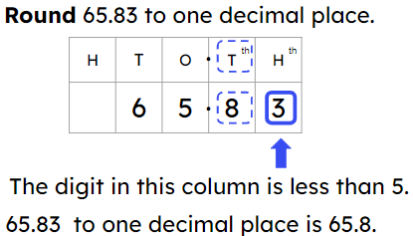
Checking understanding of rounding
Rounding is useful for showing the approximate value of something without being exact.
A number line is useful when rounding. E.g.
A place value chart is useful when rounding. E.g.
Identify the whole numbers either side of £20.25.
£20.25
£20.00
£20.50
£21.00

Slide 43

© Oak National Academy 2024.
Produced in partnership with Mathematics in Education and Industry.
Licensed on the Open Government Licence v3.0, except where otherwise stated. See Oak terms and conditions.

